Slide 1
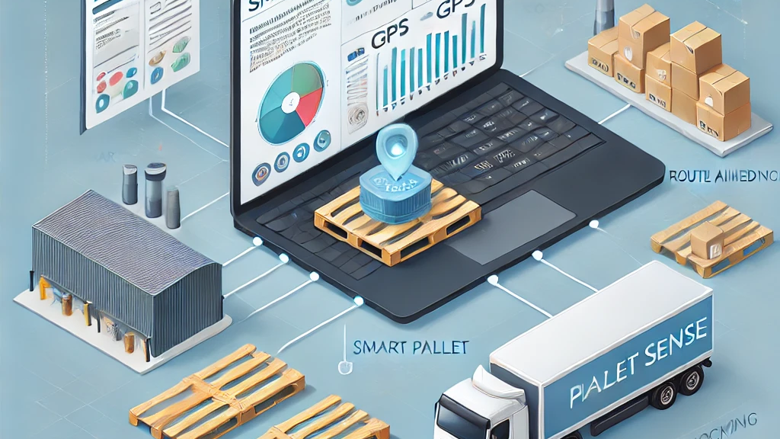
The PalletSense Challenge
Team : Geeklords
Team ID :9B699C

Slide 2
The PalletSense Challenge
Introduction
Output Analysis
Methodology
Result Interpretation
Limitation
Future and Scope
Team : GeekLords

Slide 3
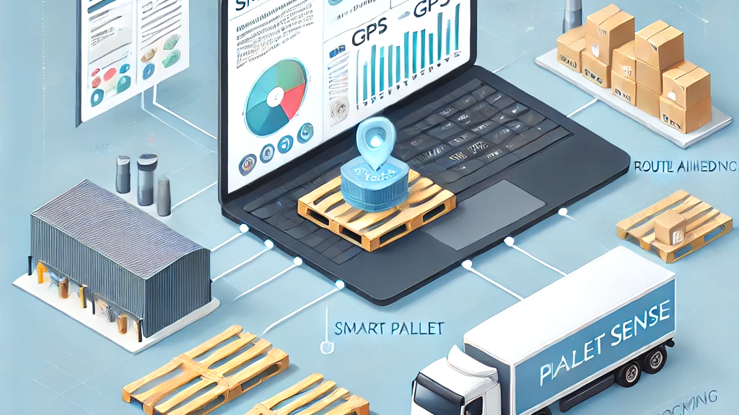
Methodology
Output Analysis
01.Introduction
Result Interpretation
Limitation
Future and Scope

Slide 4
01.Introduction
Bridging the Visibility Gap in Logistics
Problem Statement
Market insights
Objective
Methodology
Output Analysis
GPS ping limitations: 2-3 pings/day → gaps in tracking over 3-6 day journeys.
Operational losses:
30% pallet loss due to undetected deviations.
20% revenue loss from delayed billing.
36.74B(2023)→36.74B(2023)→53.21B (2032): Smart pallet market growth (CAGR: 4.2%).
Key drivers: Real-time tracking (45% adoption), security (30%), automation (25%).
Reduce pallet loss by 50% and billing delays by 30% through predictive analytics.
Result Interpretation
Limitation
Future and Scope

Slide 5
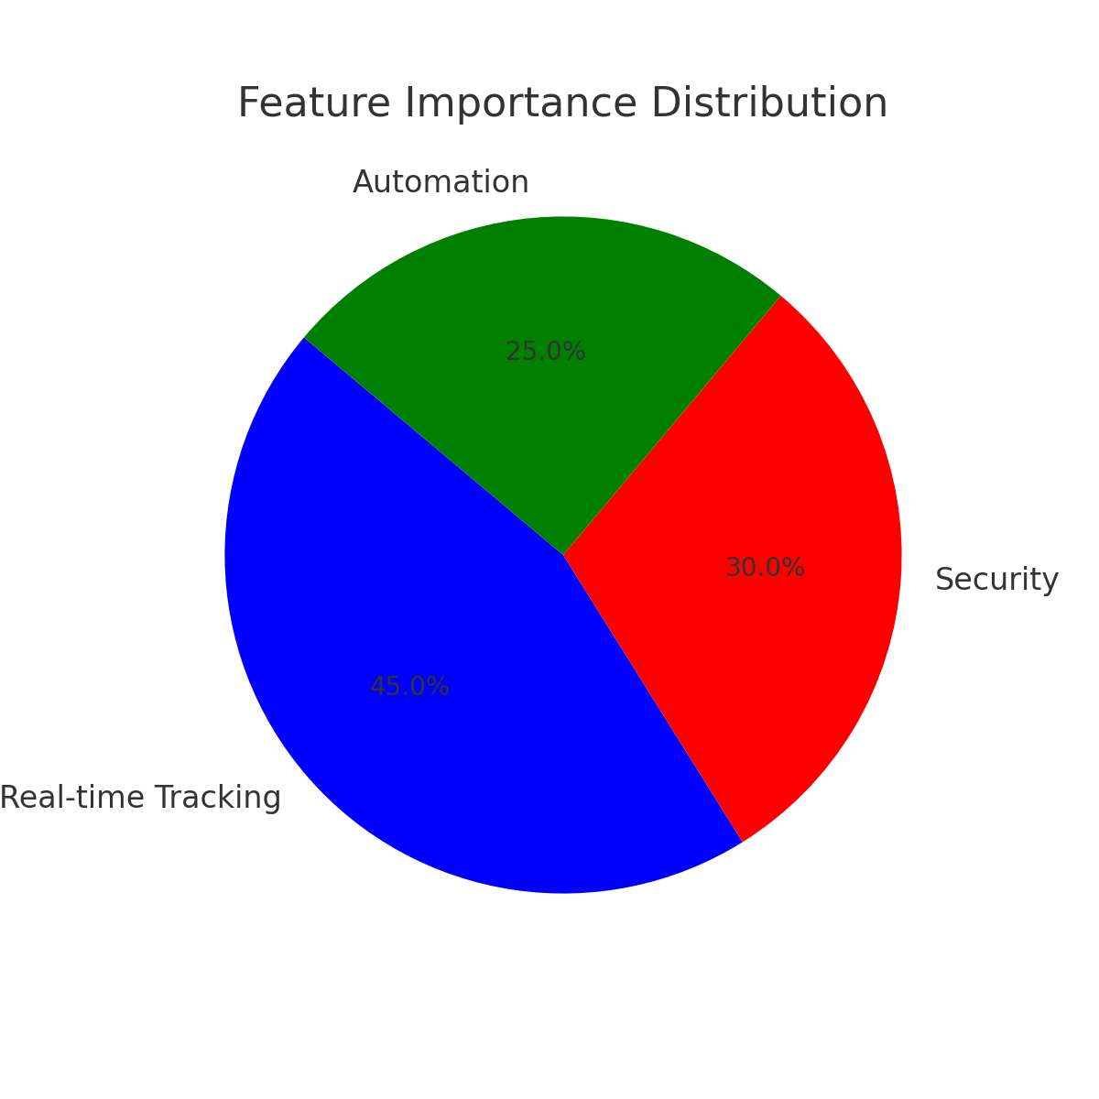
Problem Statement
Market insights
Objective
01.Introduction
Bridging the Visibility Gap in Logistics
Methodology
Output Analysis
Reduce pallet loss by 50% and billing delays by 30% through predictive analytics.
GPS ping limitations: 2-3 pings/day → gaps in tracking over 3-6 day journeys.
Operational losses:
30% pallet loss due to undetected deviations.
20% revenue loss from delayed billing.
Result Interpretation
Limitation
Future and Scope
36.74B(2023)→36.74B(2023)→53.21B (2032): Smart pallet market growth (CAGR: 4.2%).
Key drivers: Real-time tracking (45% adoption), security (30%), automation (25%).

Slide 6
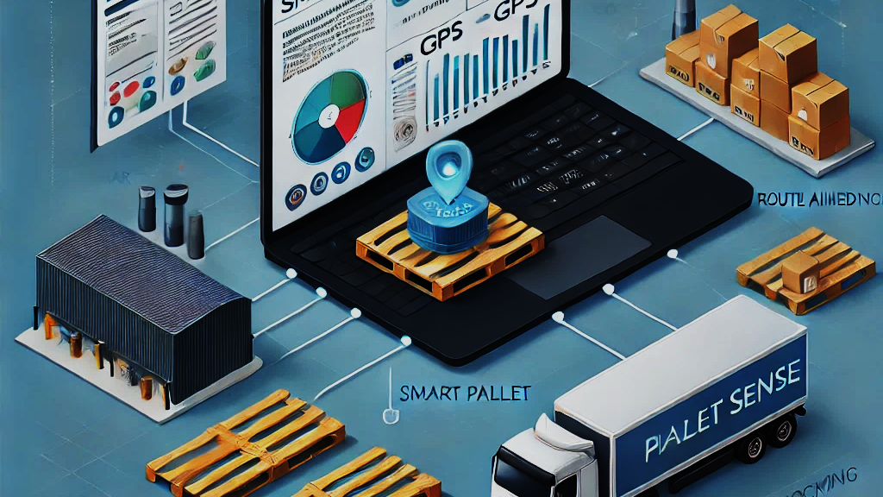
Bridging the Visibility Gap in Logistics
01.Introduction
Methodology
Output Analysis
Result Interpretation
Limitation
Future and Scope

Slide 7
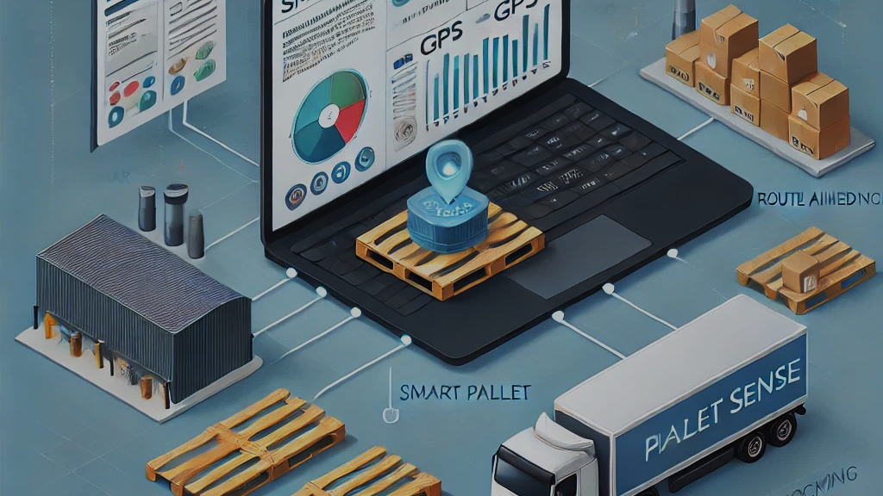
01.Introduction
Output Analysis
02.Methodology
Result Interpretation
Limitation
Future and Scope

Slide 8
01.Introduction
02.Methodology
From Raw Data to Actionable Insights
Workflow
Historical routes (10,000+ entries) + real-time pallet pings (500+ active).
Data Collection
Clean duplicates (5% data removed), geohash GPS coordinates.
Preprocessing
Group pallets using DBSCAN (density-based clustering).
Clustering
HMM (92% accuracy) to flag off-route pallets.
Anomaly Detection
Kalman Filter for location interpolation (500m accuracy).
Predictive Tracking
Output Analysis
Result Interpretation
Limitation
Future and Scope

Slide 9

01.Introduction
02.Methodology
Transforming Raw GPS Pings into Usable Data
Data Preprocessing
Historical routes (10,000+ entries) + real-time pallet pings (500+ active).
Data Collection
Clean duplicates (5% data removed), geohash GPS coordinates.
Preprocessing
Group pallets using DBSCAN (density-based clustering).
Clustering
Isolation Forest (92% accuracy) to flag off-route pallets.
Anomaly Detection
Kalman Filter for location interpolation (500m accuracy).
Predictive Tracking
Data Cleaning
Remove duplicates (5% of data) and fill missing timestamps.
Speed
The speed of information is derived from the latitude/longitude and time, differentiating between stationary and moving pallets. Acceleration is the rate of change in speed, which is proportional to the mode of transport.
Mapping to Routes
Assign pallets to historical routes using Haversine distance (1 km threshold).
Output Analysis
Result Interpretation
Limitation
Future and Scope

Slide 10

Algorithms:
DBSCAN: Cluster pallets within 500m proximity and 2-hour time windows.
Haversine Distance: Calculate distance between pallet pings and known routes.
Key Metrics:
85% adherence: Pallets stayed within 1 km of assigned routes.
15% deviation: 10% temporary (recovered), 5% permanent loss.
01.Introduction
02.Methodology
Identifying Cohorts and Mapping to Known Routes
Clustering & Route Mapping:
Grouping Pallets
Data Cleaning
Remove duplicates (5% of data) and fill missing timestamps.
Geohashing
Convert latitude/longitude to 6-digit geohash codes (e.g., "9v8yq1")
Mapping to Routes
Assign pallets to historical routes using Haversine distance (1 km threshold).
Output Analysis
Result Interpretation
Limitation
Future and Scope

Slide 11

Algorithms:
DBSCAN: Cluster pallets within 500m proximity and 2-hour time windows.
Haversine Distance: Calculate distance between pallet pings and known routes.
Key Metrics:
85% adherence: Pallets stayed within 1 km of assigned routes.
15% deviation: 10% temporary (recovered), 5% permanent loss.
01.Introduction
02.Methodology
Isolation Forest for Spatial Outlier Detection
Algorithm
Functioning
HMM (Hidden Markov Model)
HMM is great for predicting missing locations when GPS data is sparse.
When a pallet goes missing (no pings for an extended time), HMM predicts where it might have gone based on past movements.
If a pallet stops transmitting before reaching a known destination, it’s flagged as lost.
Anomaly Detection: Flagging Off-Route Pallets
Output Analysis
Result Interpretation
Limitation
Future and Scope

Slide 12
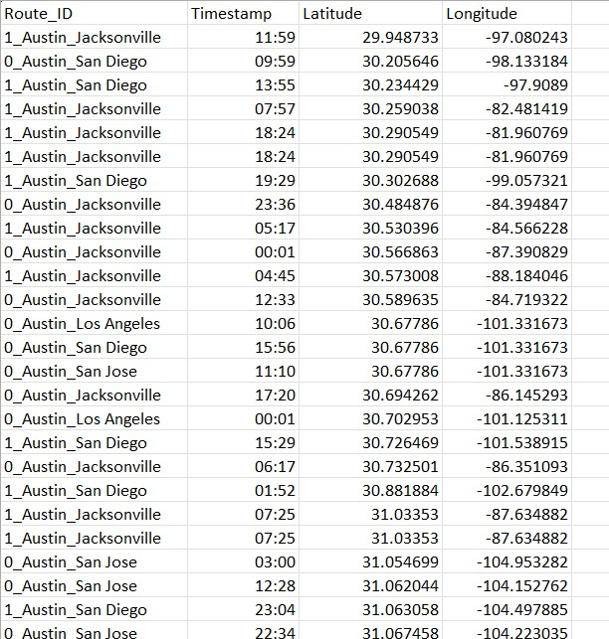
01.Introduction
02.Methodology
Algorithm
Functioning
HMM (Hidden Markov Model)
HMM is great for predicting missing locations when GPS data is sparse.
When a pallet goes missing (no pings for an extended time), HMM predicts where it might have gone based on past movements.
If a pallet stops transmitting before reaching a known destination, it’s flagged as lost.
Real-Time Alerts for Deviations and Stationary Pallets
Alert System:
Proactive Intervention
Off-Route: >1 km deviation → SMS/email alert to logistics team.
Stationary: >48 hrs at a location → billing recovery alert.
ALERT!!!
Output Analysis
Result Interpretation
Limitation
Future and Scope

Slide 13
Real-Time Alerts for Deviations and Stationary Pallets
01.Introduction
Alert System:
Proactive Intervention
Off-Route: >1 km deviation → SMS/email alert to logistics team.
Stationary: >48 hrs at a location → billing recovery alert.
ALERT!!!
02.Methodology
Output Analysis
Result Interpretation
Limitation
Future and Scope

Slide 14
Real-Time Alerts for Deviations and Stationary Pallets
01.Introduction
Alert System:
Proactive Intervention
Off-Route: >1 km deviation → SMS/email alert to logistics team.
Stationary: >48 hrs at a location → billing recovery alert.
ALERT!!!
02.Methodology
03.Output Analysis
Result Interpretation
Limitation
Future and Scope

Slide 15
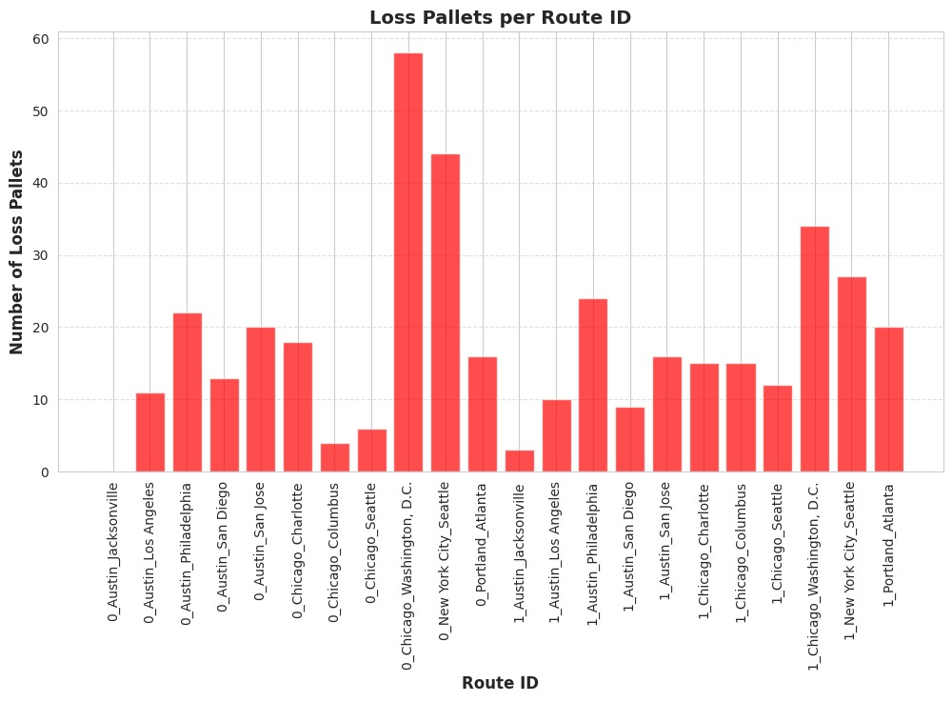
01.Introduction
03.Output Analysis
Route Adherence: Measuring Compliance
Results
Off-Route: >1 km deviation → SMS/email alert to logistics team.
Stationary: >48 hrs at a location → billing recovery alert.
ALERT!!!
02.Methodology
On-Route
Deviations
15% (10% recovered, 5% lost).
85% of pallets stayed within 1km of assigned routes
Result Interpretation
Limitation
Future and Scope

Slide 16
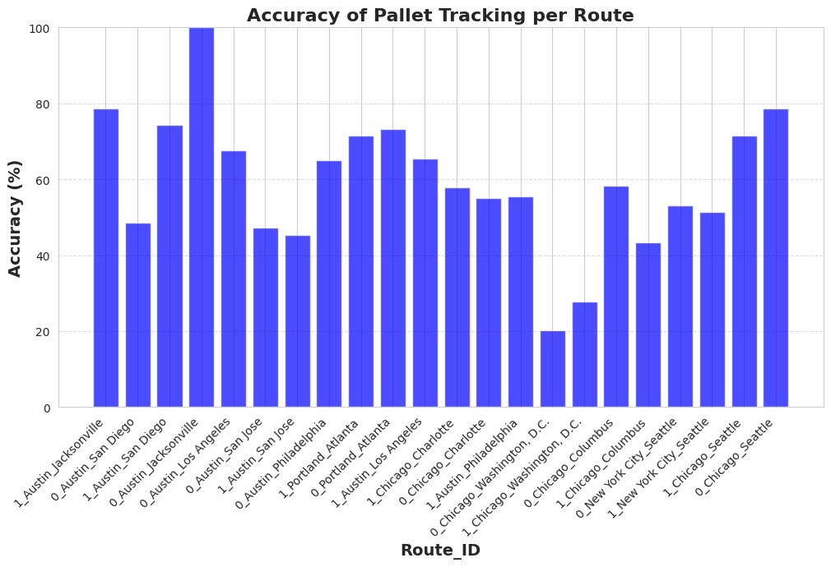
01.Introduction
03.Output Analysis
Deviation Detection: Accuracy & Impact
Deviation Detection
Metrics:
True Positives : 88% ( Correctly flagged deviations)
Case Study
$15,000 saved/month by recovering 10% deviated pallets
False Positives : 12% (False Alerts)
Off-Route: >1 km deviation → SMS/email alert to logistics team.
Stationary: >48 hrs at a location → billing recovery alert.
ALERT!!!
02.Methodology
On-Route
Deviations
15% (10% recovered, 5% lost).
85% of pallets stayed within 1km of assigned routes
Result Interpretation
Limitation
Future and Scope

Slide 17
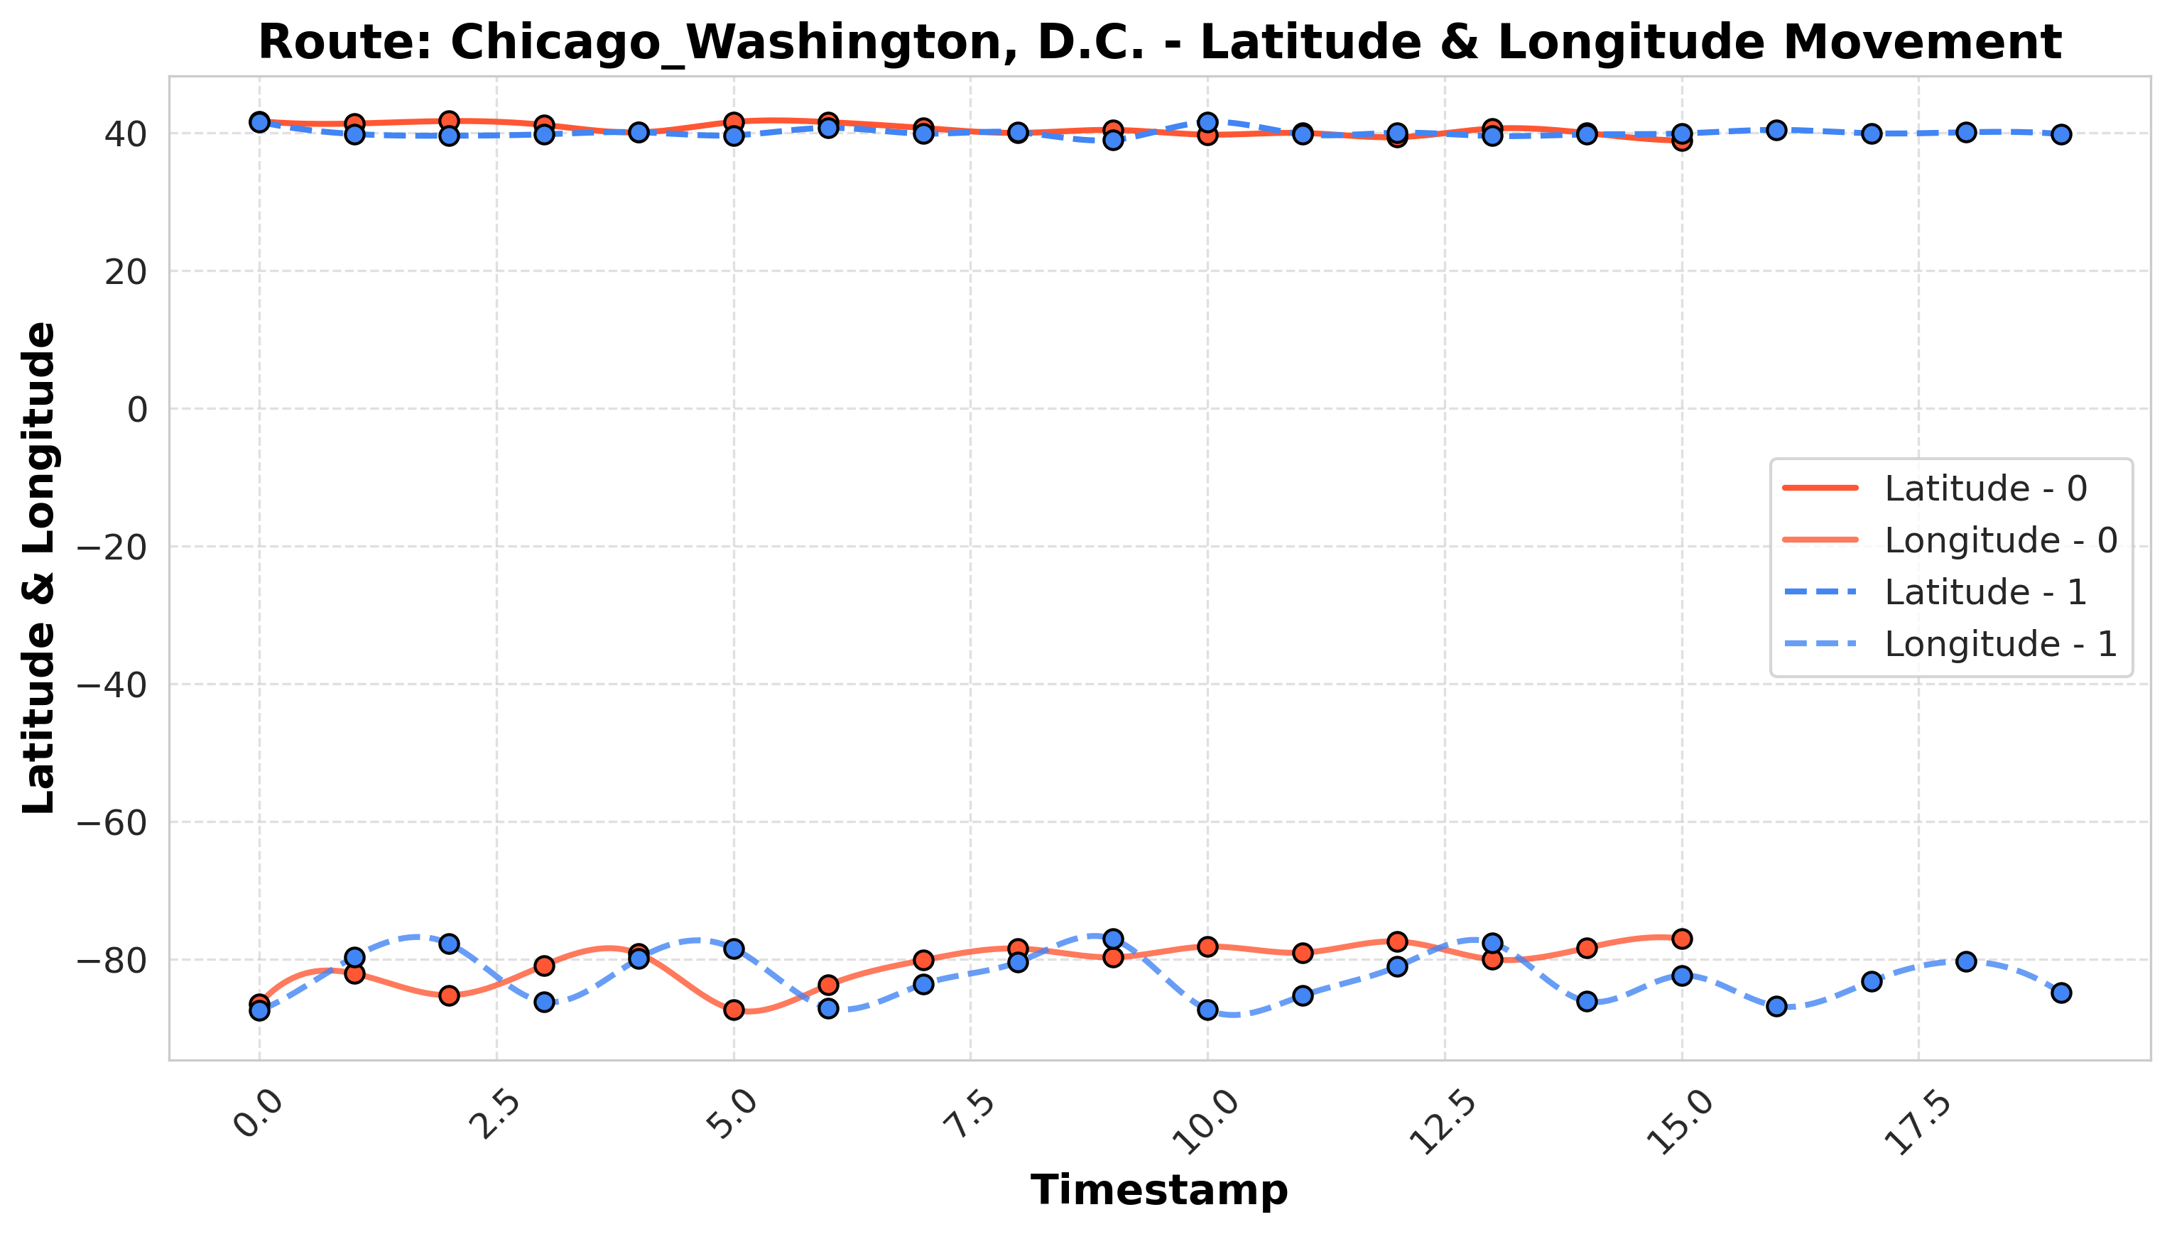
10% of pallets stayed >48 hrs at customer locations.
$15,000/month recovered through alerts.
01.Introduction
03.Output Analysis
Stationary Pallets: Billing Recovery
Stationary Pallets
Metrics:
True Positives : 88% ( Correctly flagged deviations)
Case Study
$15,000 saved/month by recovering 10% deviated pallets
False Positives : 12% (False Alerts)
02.Methodology
Result Interpretation
Limitation
Findings
Future and Scope

Slide 18
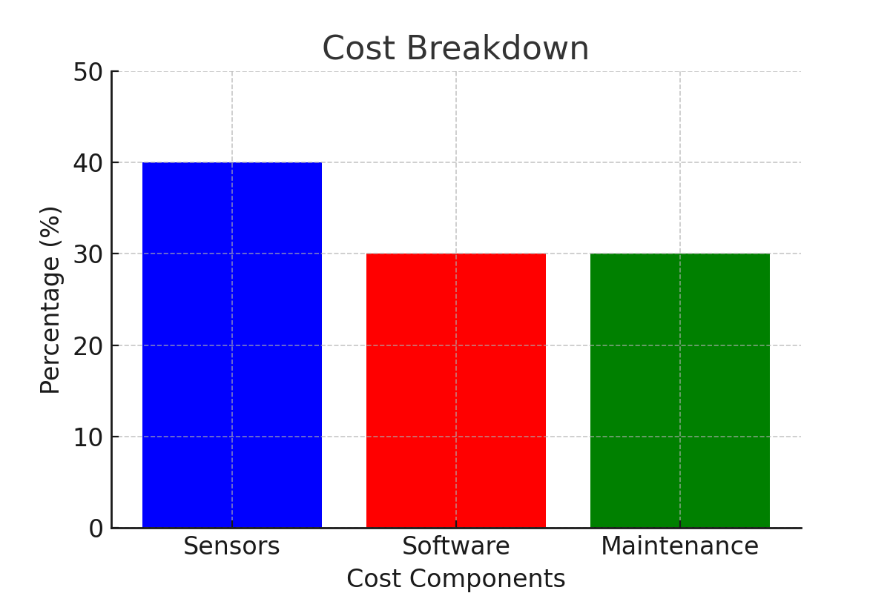
10% of pallets stayed >48 hrs at customer locations.
$15,000/month recovered through alerts.
01.Introduction
03.Output Analysis
Cost-Benefit Analysis: ROI in 12 Months
Cost-Benefit
02.Methodology
Savings
45000$/month: reduced pallet loss and billing recovery.
Cost Breakdown
Sensors:40%, Software: 30%, Maintenance: 30%.
ROI: 12 months (vs. $150/pallet cost).
Result Interpretation
Limitation
Findings
Future and Scope

Slide 19
Cost-Benefit Analysis: ROI in 12 Months
Cost-Benefit
01.Introduction
02.Methodology
03.Output Analysis
Savings
45000$/month: reduced pallet loss and billing recovery.
Cost Breakdown
Sensors:40%, Software: 30%, Maintenance: 30%.
ROI: 12 months (vs. $150/pallet cost).
Result Interpretation
Limitation
Future and Scope

Slide 20
01.Introduction
02.Methodology
Cost-Benefit Analysis: ROI in 12 Months
03.Output Analysis
Cost-Benefit
04.Result Interpretation
Limitation
Future and Scope

Slide 21
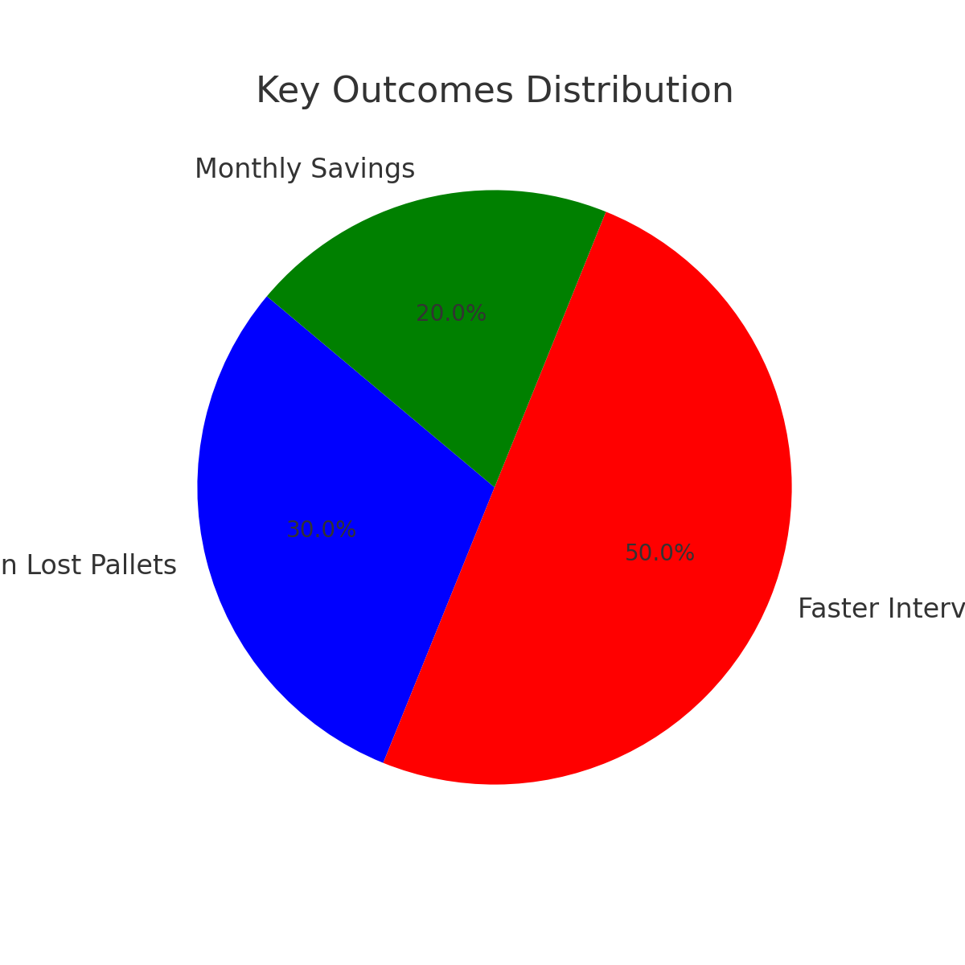
01.Introduction
02.Methodology
03.Output Analysis
04.Result Interpretation
Result Interpretation: Business Impact
Key Findings
30% reduction in lost pallets.
50% faster interventions due to real-time alerts.
$45,000/month savings.
Limitation
Future and Scope

Slide 22
Result Interpretation: Business Impact
Key Findings
01.Introduction
30% reduction in lost pallets.
50% faster interventions due to real-time alerts.
$45,000/month savings.
02.Methodology
03.Output Analysis
04.Result Interpretation
Limitation
Future and Scope

Slide 23
01.Introduction
02.Methodology
03.Output Analysis
Result Interpretation: Business Impact
Key Findings
05.Limitation
04.Result Interpretation
Future and Scope

Slide 24
01.Introduction
02.Methodology
03.Output Analysis
05.Limitation
Limitations: Challenges in Implementation
Limitations
Classification:
Lack of historical data for new routes.
Scalability: High-frequency data streams strain processing.
04.Result Interpretation
Future and Scope

Slide 25
05.Limitation
Limitations: Challenges in Implementation
01.Introduction
Limitations
02.Methodology
03.Output Analysis
Classification:
Lack of historical data for new routes.
Scalability: High-frequency data streams strain processing.
06.Future and Scope
04.Result Interpretation

Slide 26
05.Limitation
Limitations: Challenges in Implementation
01.Introduction
Limitations
02.Methodology
03.Output Analysis
Classification:
Lack of historical data for new routes.
Scalability: High-frequency data streams strain processing.
06.Future and Scope
04.Result Interpretation

Slide 27
05.Limitation
01.Introduction
Limitations
02.Methodology
03.Output Analysis
06.Future and Scope
Future & Scope: Towards Supply Chain 4.0
AI-Driven Predictive Maintenance: Reduce sensor failures by 25%.
Blockchain: Secure data sharing with suppliers (e.g., Walmart, Amazon).
Hybrid Connectivity: Combine NB-IoT and satellite for 100% coverage.
04.Result Interpretation

Slide 28
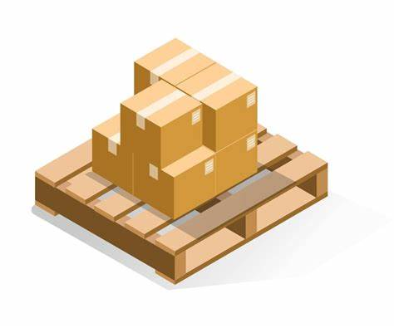
Future & Scope: Towards Supply Chain 4.0
Limitations
01.Introduction
AI-Driven Predictive Maintenance: Reduce sensor failures by 25%.
Hybrid Connectivity: Combine NB-IoT and satellite for 100% coverage.
02.Methodology
03.Output Analysis
04.Result Interpretation
05.Limitation
06.Future and Scope
Blockchain: Secure data sharing with suppliers (e.g., Walmart, Amazon).

Slide 29
Future & Scope: Towards Supply Chain 4.0
PalletSense Systems
01.Introduction
02.Methodology
03.Output Analysis
05.Limitation
04.Result Interpretation
06.Future and Scope
Monitoring Dashboard

Slide 30
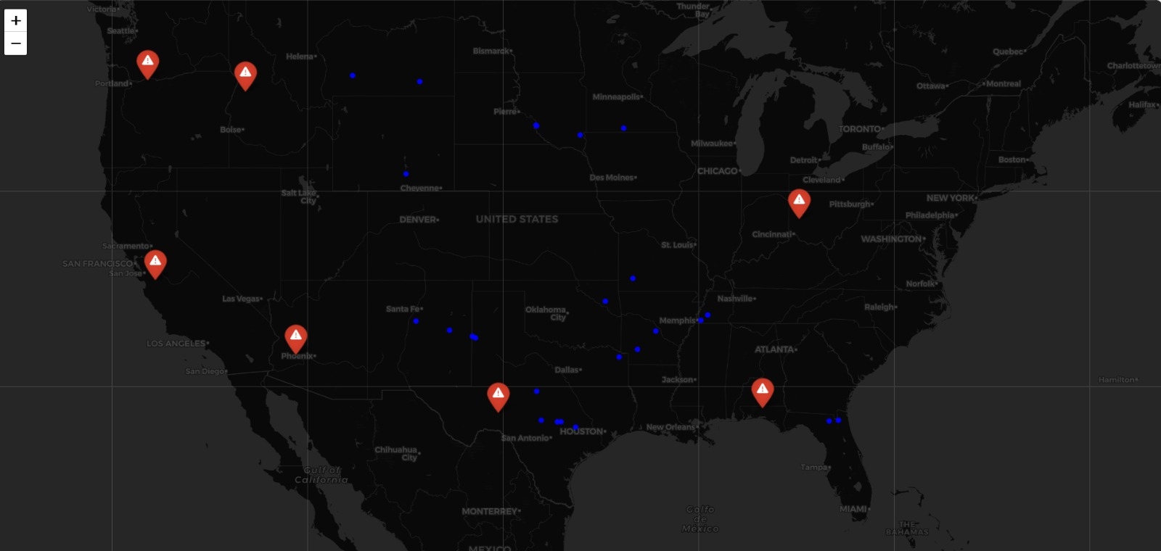
01.Introduction
02.Methodology
03.Output Analysis
04.Result Interpretation
05.Limitation
Future & Scope: Towards Supply Chain 4.0
06.Future and Scope
PalletSense Systems
Monitoring Dashboard
(Hotspots)

Slide 31
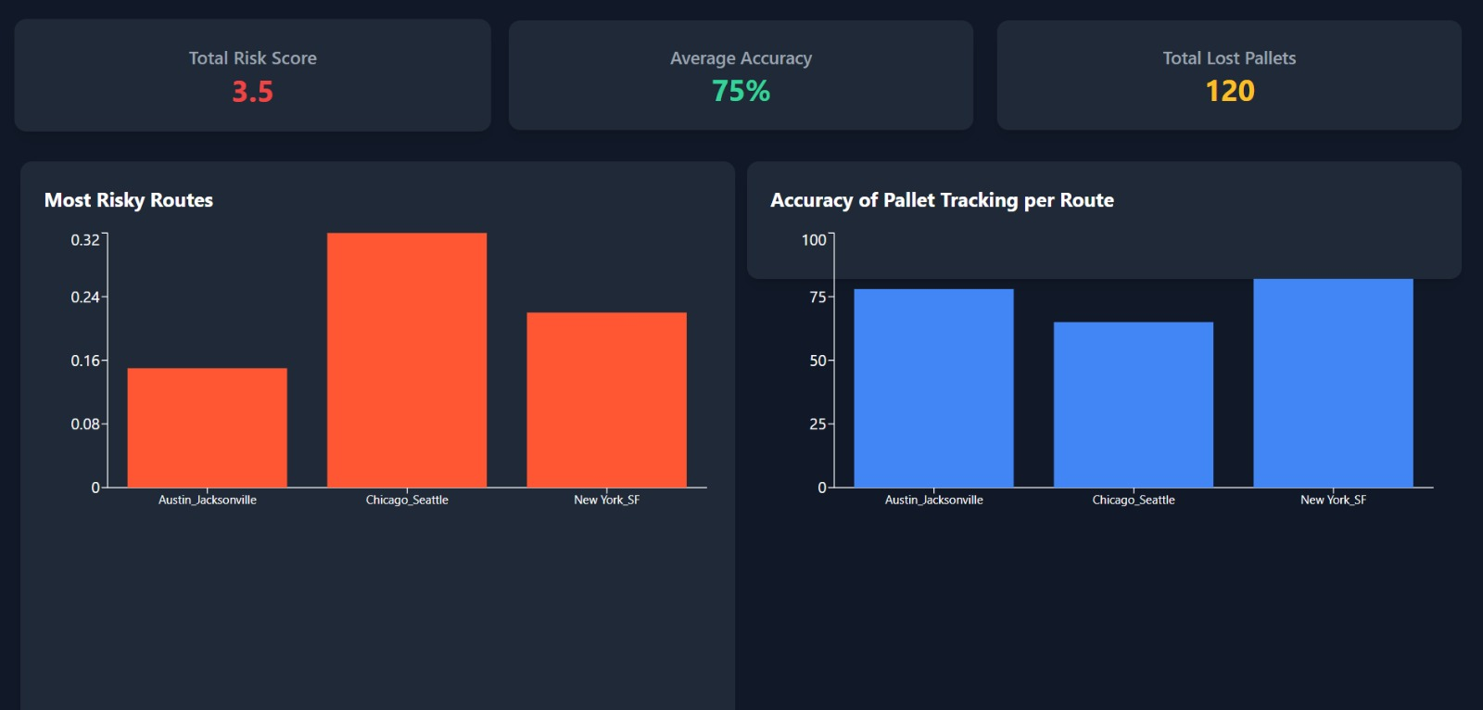
PalletSense Systems
Monitoring Dashboard

Slide 32
PalletSense Systems
Thank You!
Questions and feedbacks are welcomed!

